Slide 1
Card Game System
Ryan Bickham
Nicholas Borushko
Ryan Gillett
Andrew Haeger

Slide 2
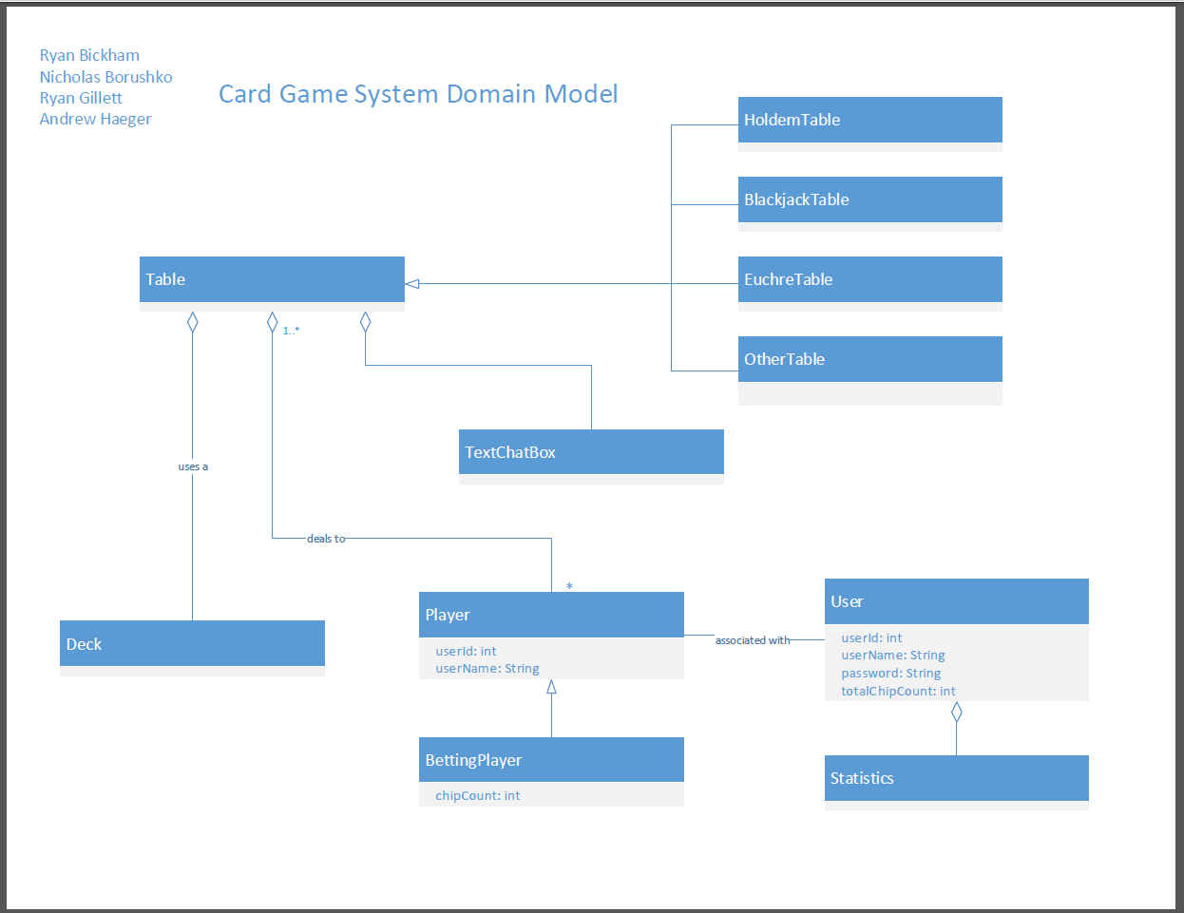
Basic Design

Slide 3
UC: Join a Table
UC: Join a Table
Actor: User | System: Card Game System
 | 0. System displays the home screen. (Figure 1)
1. TUCBW the user clicking Start Playing Now | 2. The system displays the page with a list of available games. (Figure 2)
3. The user chooses a game they would like to play. | 4. The system displays a list of tables based on the chosen game. (Figure 3)
5. The user clicks Join Table on the table they would like to play at. | 6. The system displays the game and the table to the user. (Figure 4)
7. The user begins to play the game.

Slide 4
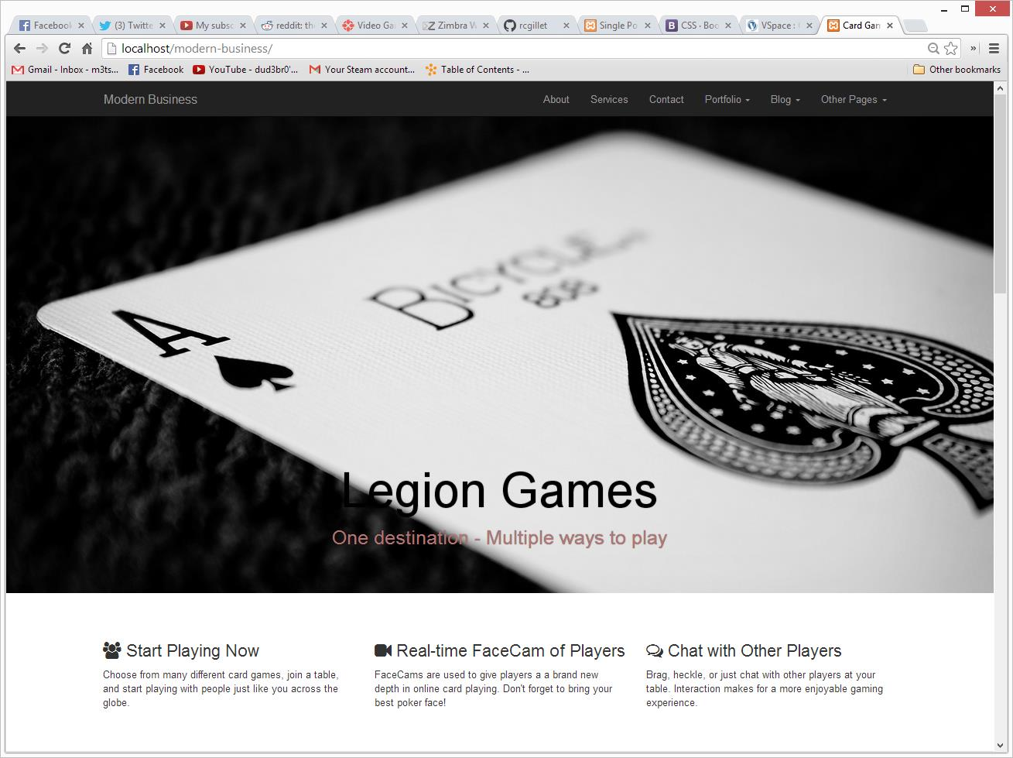
Figure 1

Slide 5
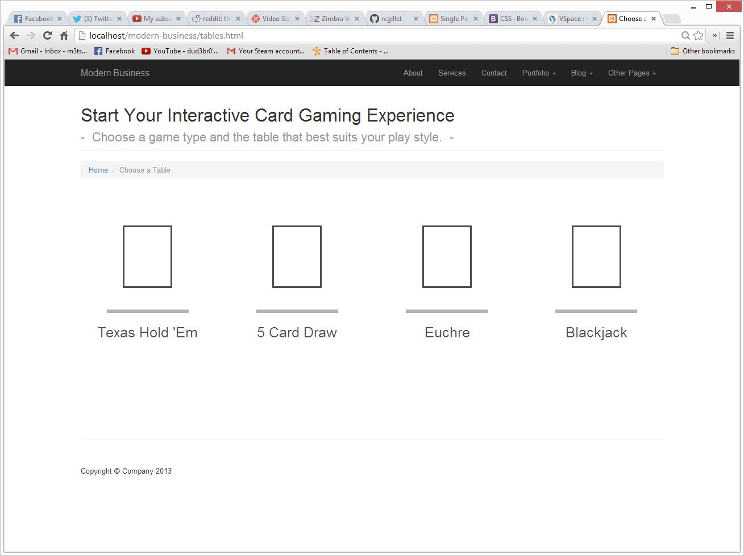
Figure 2

Slide 6
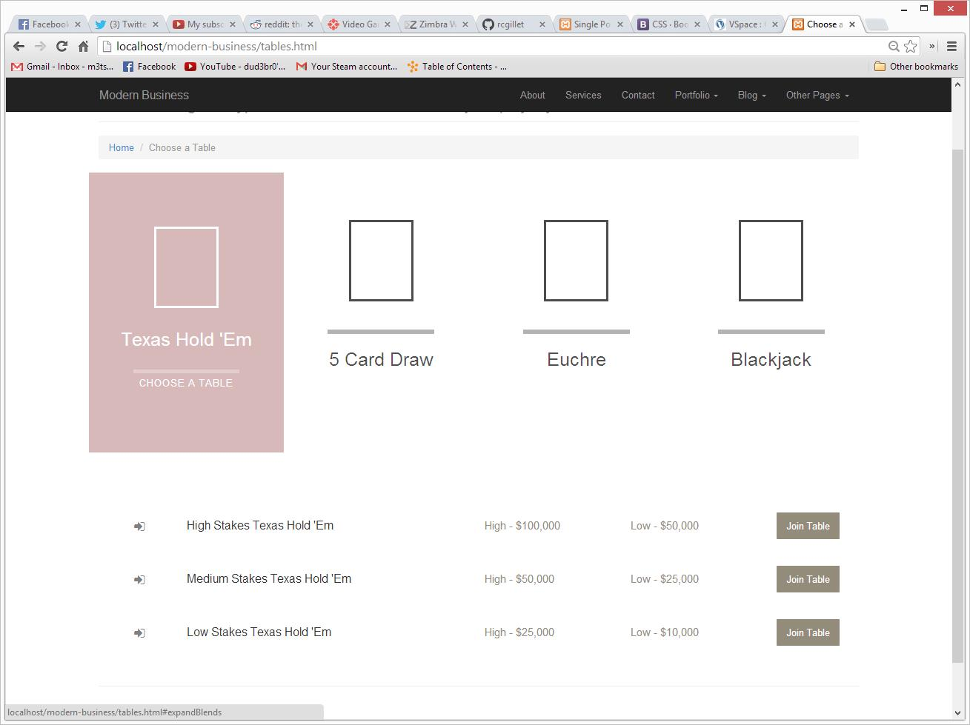
Figure 3

Slide 7
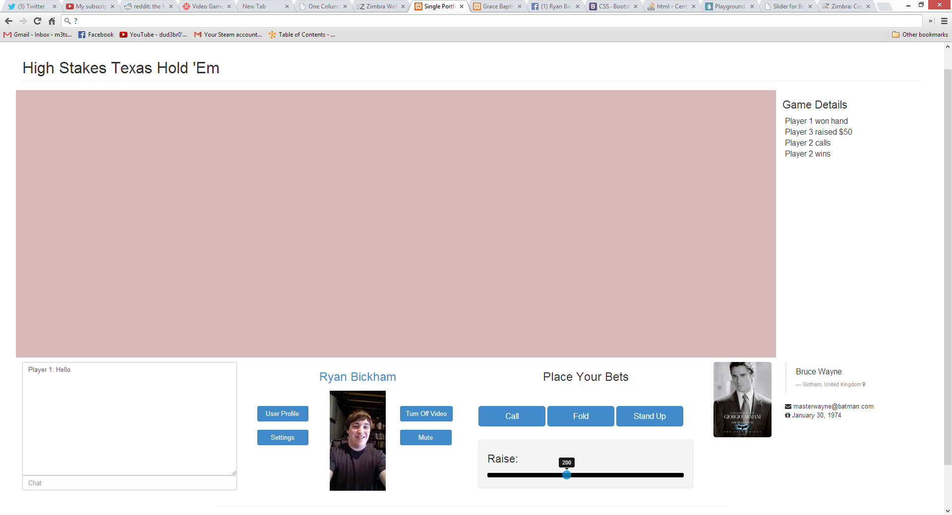
Figure 4

Slide 8
UC: Message Other Users
UC: Message Other Users
Actor: User | System: Card Game System
 | 0. System displays a game/table.
1. The user clicks on the chat text input field, types a message, and clicks send. (Figure 5) | 2. The system displays the message entered to everyone at the table. (Figure 4)
3. The user reads the messages sent by other users.

Slide 9
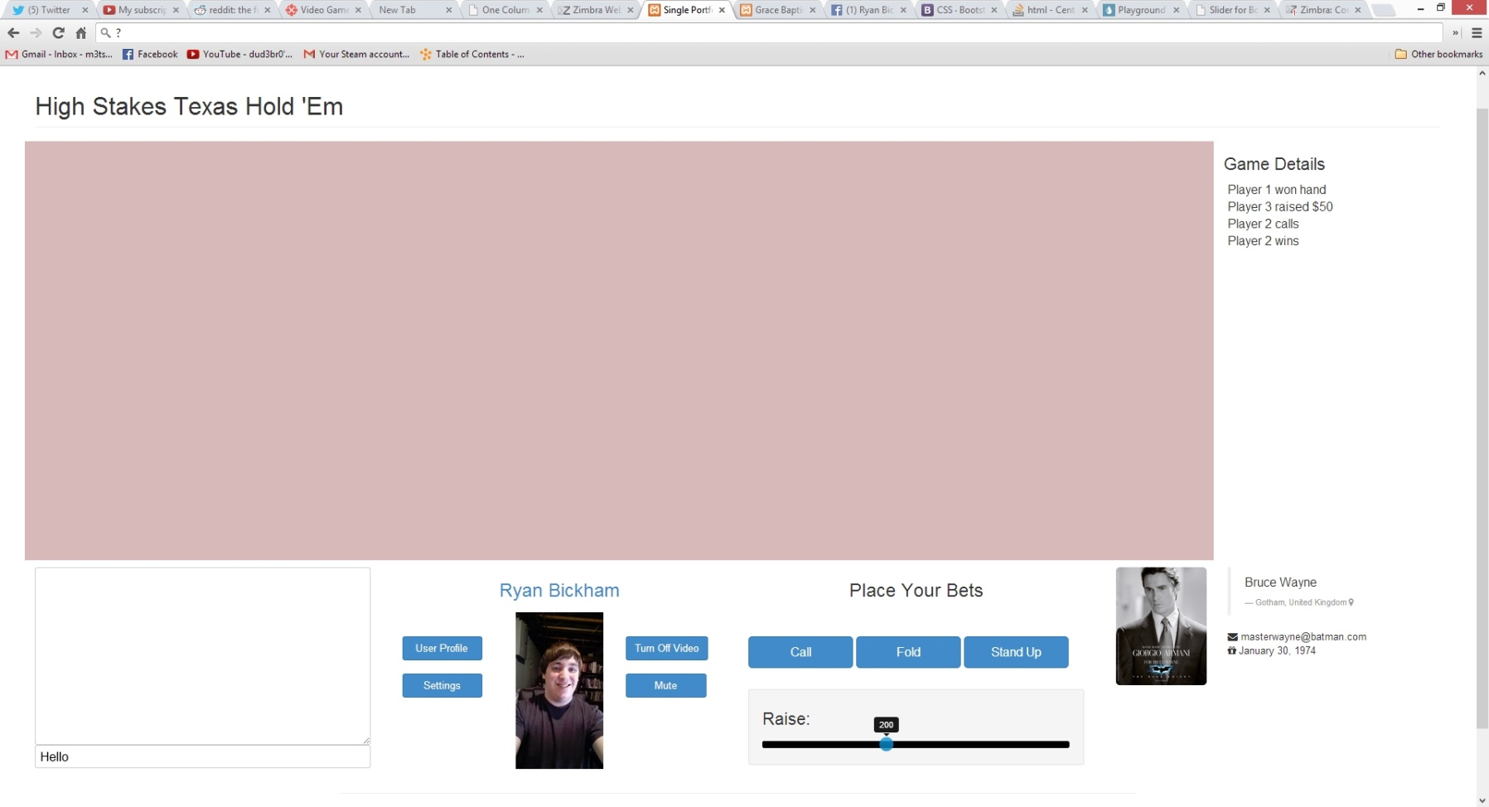
Figure 5

Slide 10
Figure 4

